Slide 1
Convolutional Neural Network
Week 3

Slide 2
Learning Outcomes
Discuss the structure and functionality of convolutional layers, pooling layers, and fully connected layers.
Design and implement a simple CNN for image classification using TensorFlow or PyTorch.
Evaluate the performance of the CNN using metrics like accuracy and loss on a validation dataset.

Slide 3
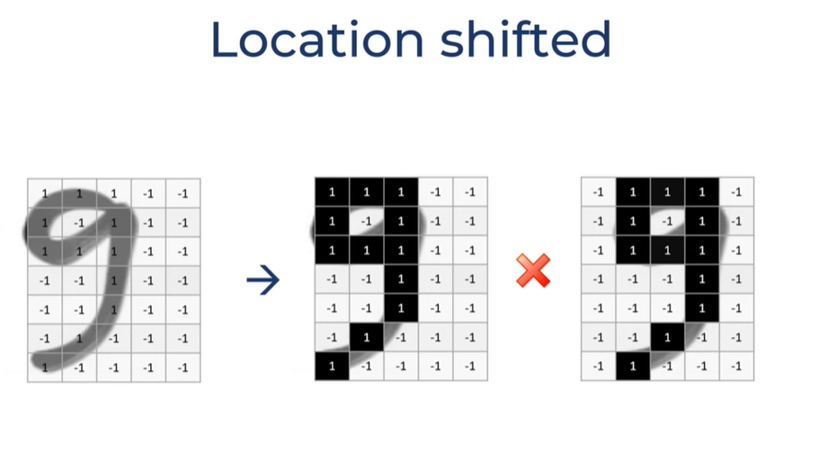

Slide 4
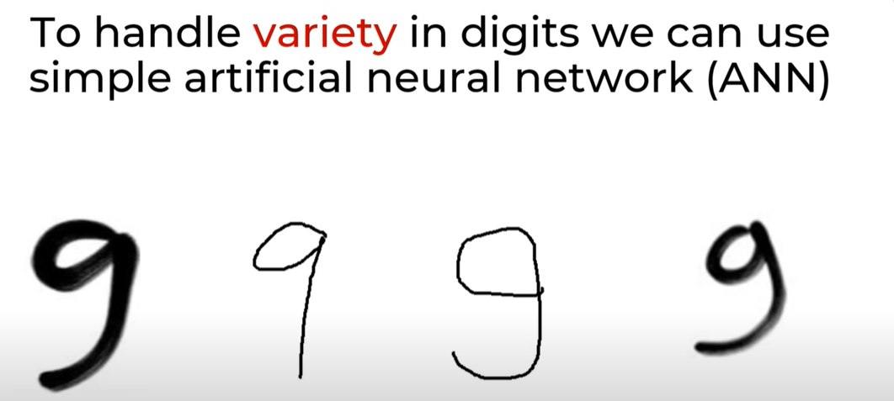

Slide 5
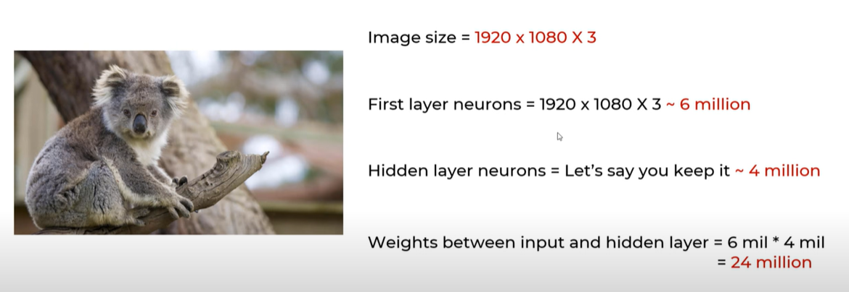

Slide 6
Disadvantages of using ANN for Images Classification
Too much computation
Treats local pixels same as pixels far apart
Sensitive to location of an object in an image

Slide 7
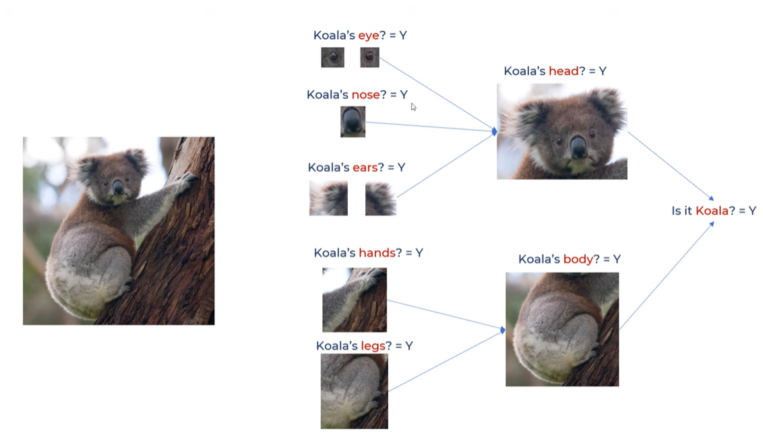

Slide 8
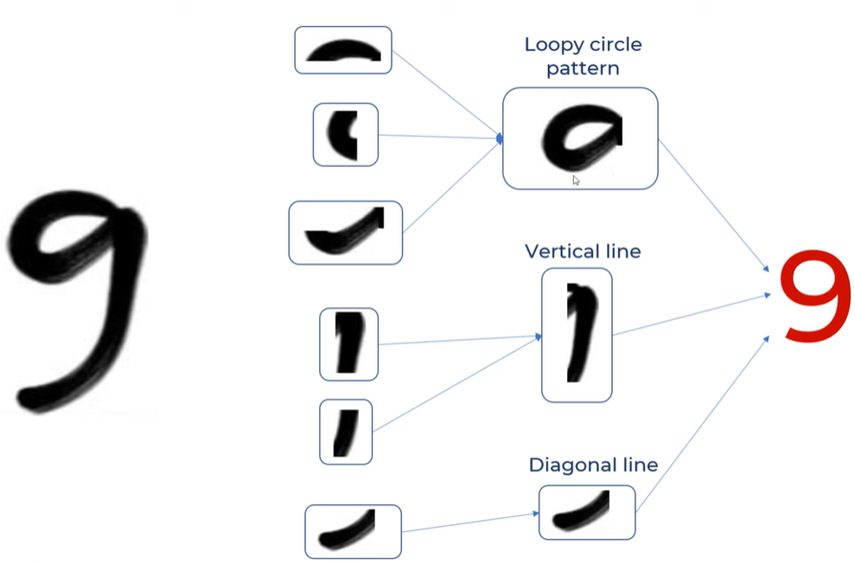

Slide 9
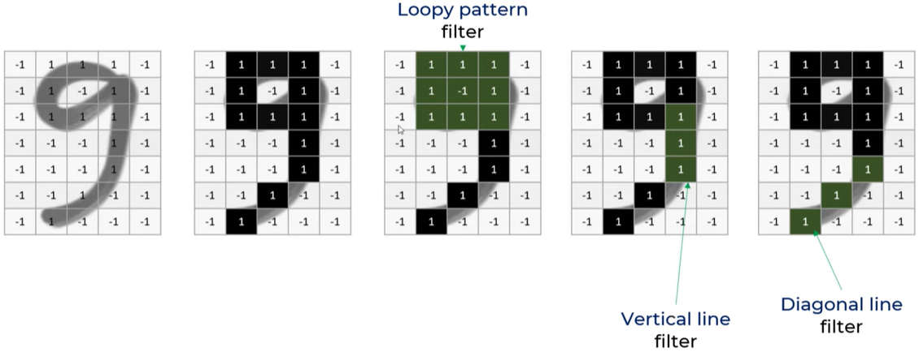
How do we make computers recognize these little features

Slide 10
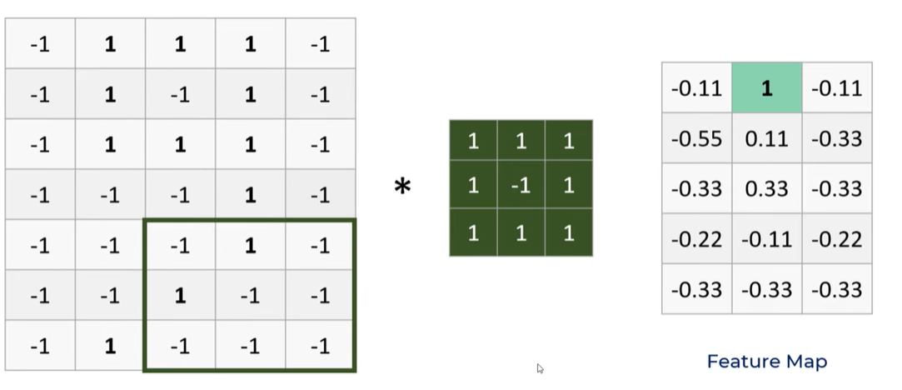
Feature detectors(Filters), Strides, Feature map

Slide 11
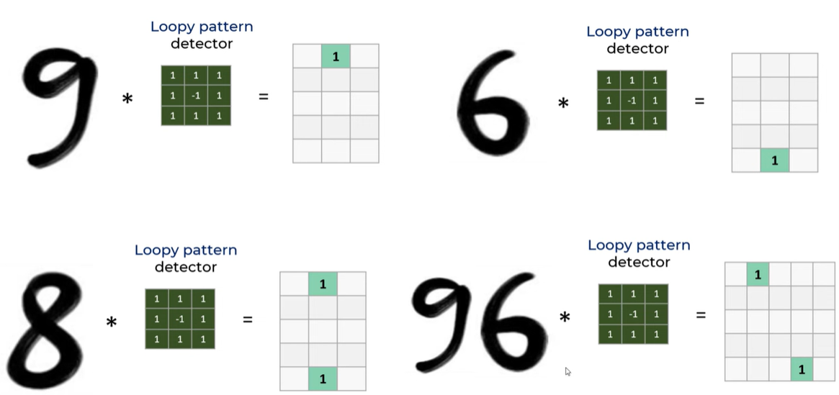

Slide 12
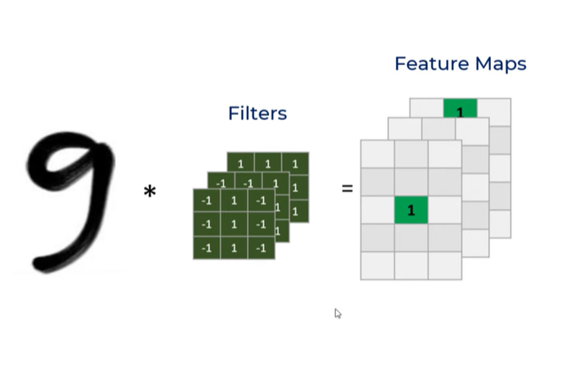
3 Filters
Loop pattern filter
Vertical line filter
Diagonal line (Tail) filter
The 3 filters result in 3 feature maps stuck together

Slide 13
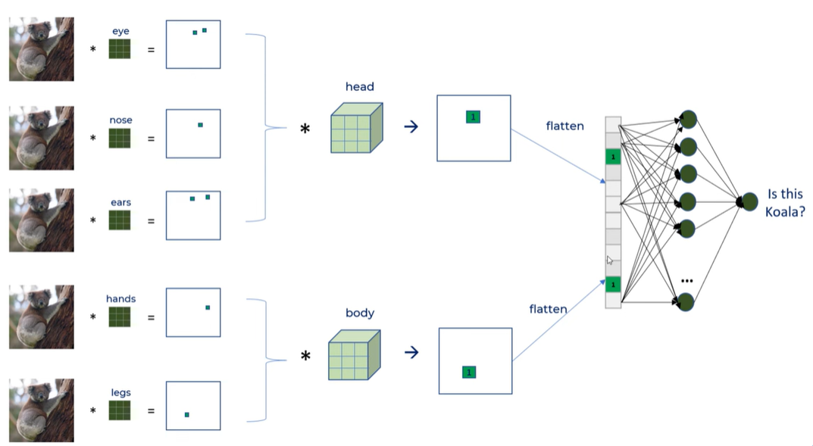
3 D Filter
Feature Extraction
Classification
Head detector
Feature map
Fully Connected dense network for the classification It should handle variety of inputs in a generic way
Body detector

Slide 14
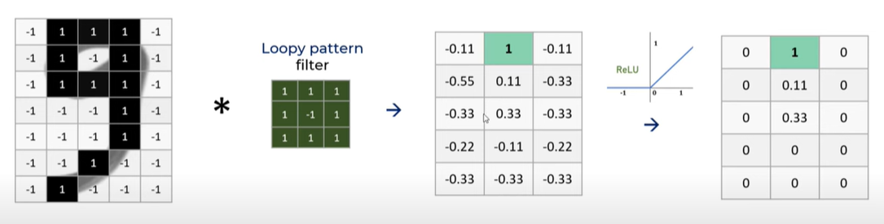
ReLU helps make the model nonlinear
Negative values are replaced with a zero Positive values are retained.

Slide 15
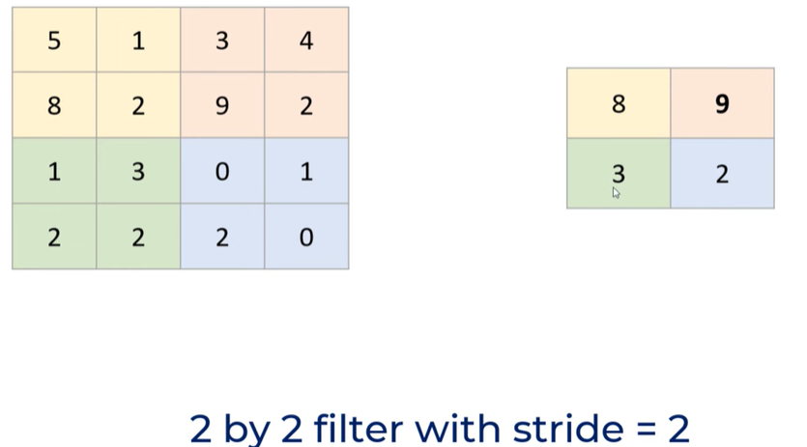
Pooling is used to reduce the size (dimension)
New feature map
Take the feature map (16)
Apply the 2x2 filter
Pick the highest value
Generate new smaller feature map (4)
The feature reduction saves on computation
Pooling reduces overfitting as there are less parameters
Model is tolerant towards variations, distortions

Slide 16
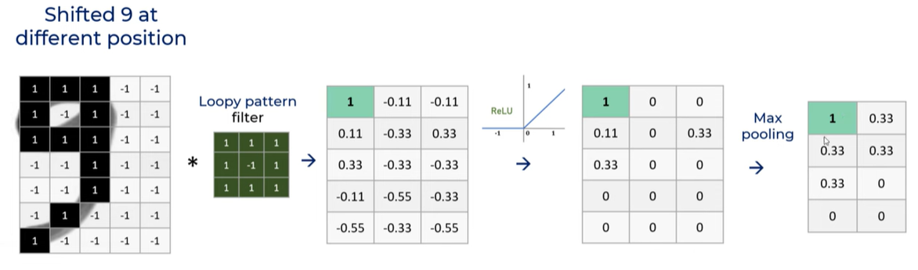
With a slide of 1

Slide 17
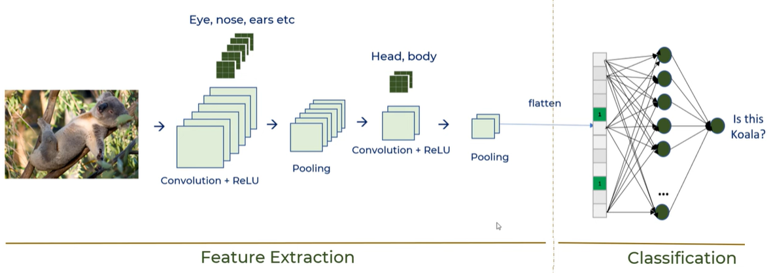
A complete CNN

Slide 18
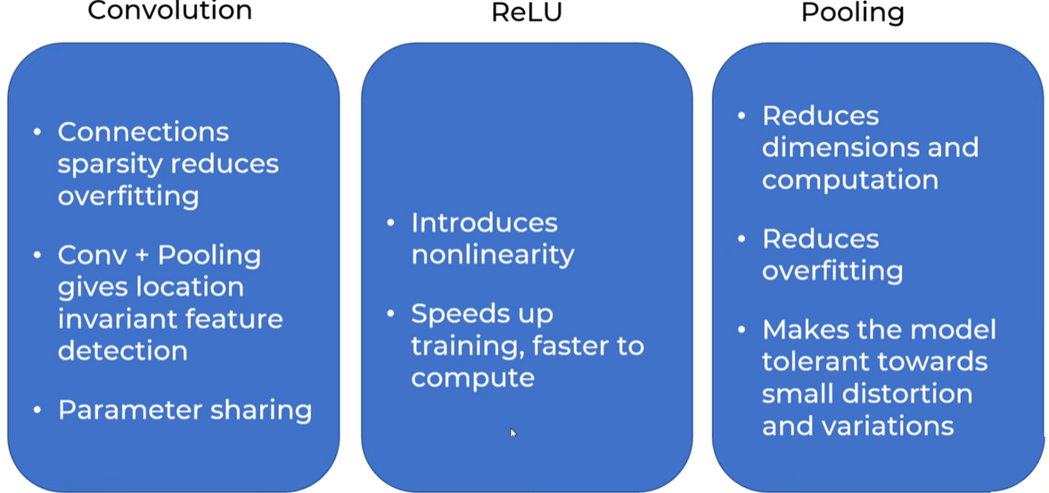
Advantages of Convolutions
Connections sparsity reduces overfitting
Convolution + Pooling gives location invariant feature detection
Parameter sharing

Slide 19

How does CNN handle Rotation and Thickness
CNN by itself does not take care of rotation and scale
You need to have rotated, scaled samples in the training dataset
If there aren’t such samples, then use data augmentation methods to generate new rotated/scaled samples from existing training samples.

Slide 20
References
https://www.youtube.com/watch?v=zfiSAzpy9NM

